Slide 1
Metric vs Imperial

Slide 2
What is metric? What about imperial?

Slide 3
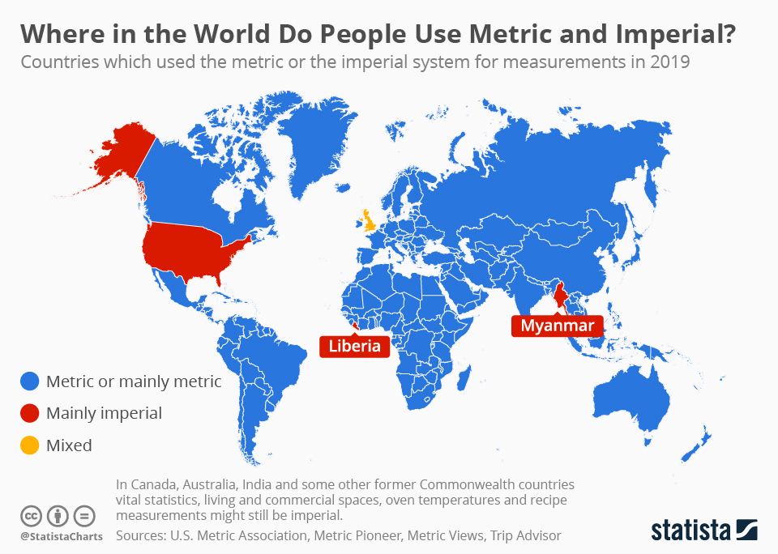

Slide 4
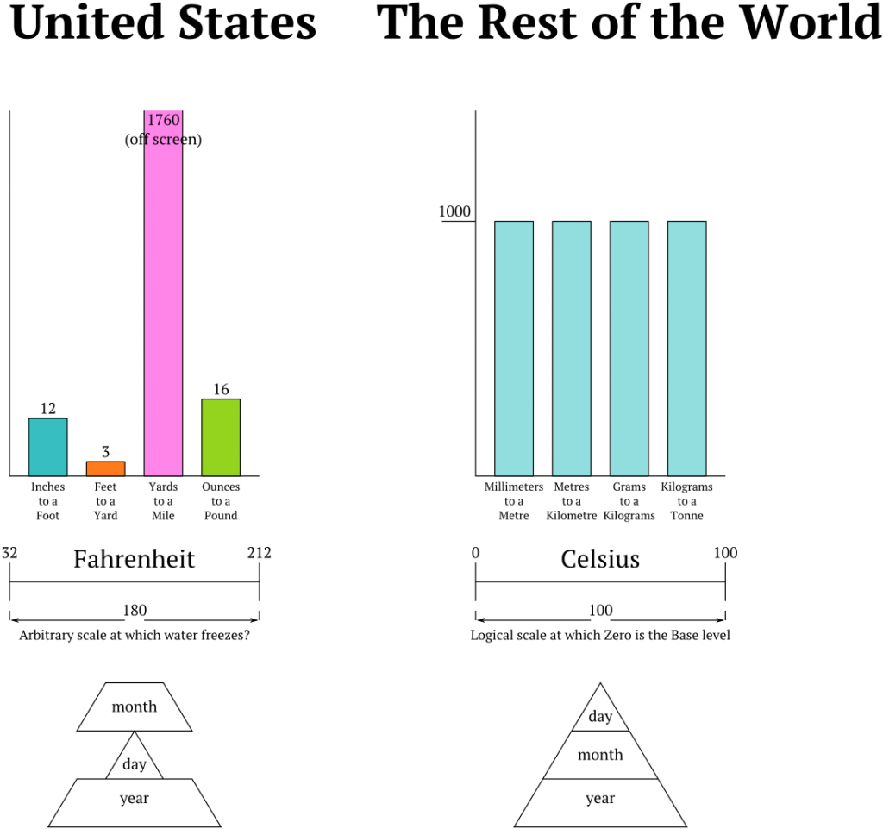

Slide 5
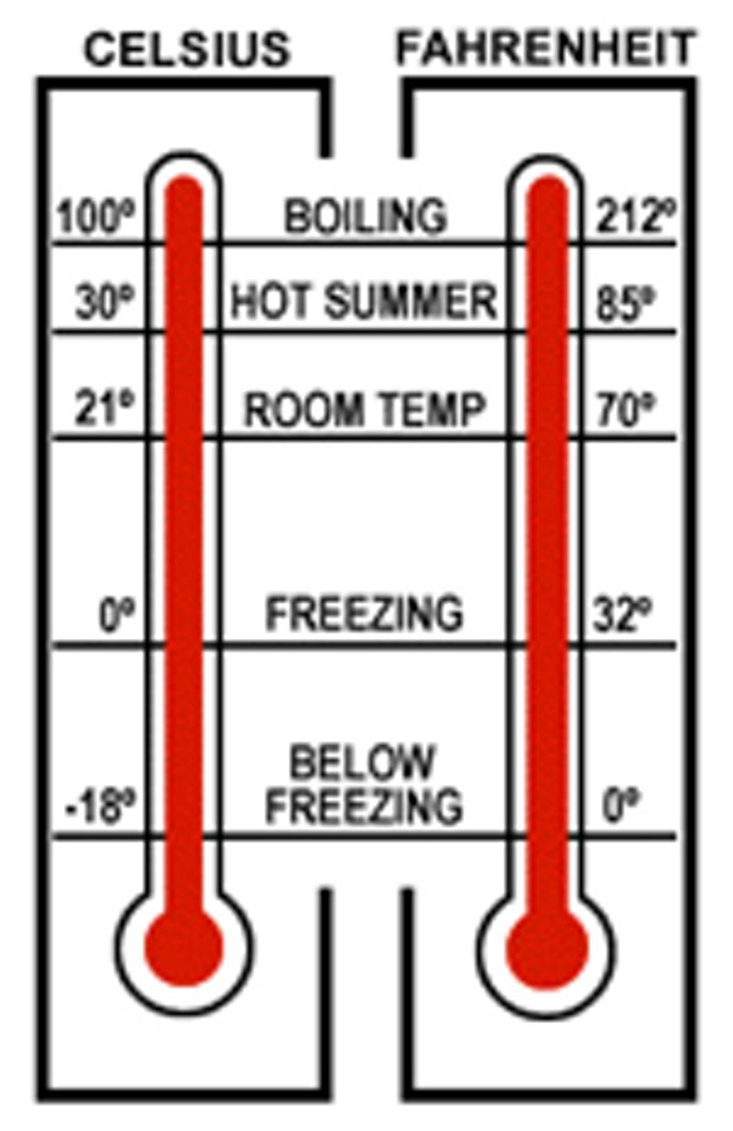

Slide 6
Let’s do some math!
1 inch = 2.5cm
1 foot = 12 inches = 30 cm
1 yard = 3 feet = 36 inches = 90 cm
5 miles = 8km

